Slide 1
Module 7: Tax Basics
“Certainty? In this world nothing is certain but
death and taxes.”
―Benjamin Franklin

Slide 2
Learning Objectives:
What are the types of taxes you will pay?
Learn which paperwork you need to keep.
Learn how to file income tax.
Making your tax payments.

Slide 3
What to Know:
Taxes: Only pay what you owe and not a penny more!!
Taxes have a significant impact on your life and your financial planning. You must:
know current tax laws
keep thorough tax records
make decisions that reduce
your tax liability as much as possible

Slide 4
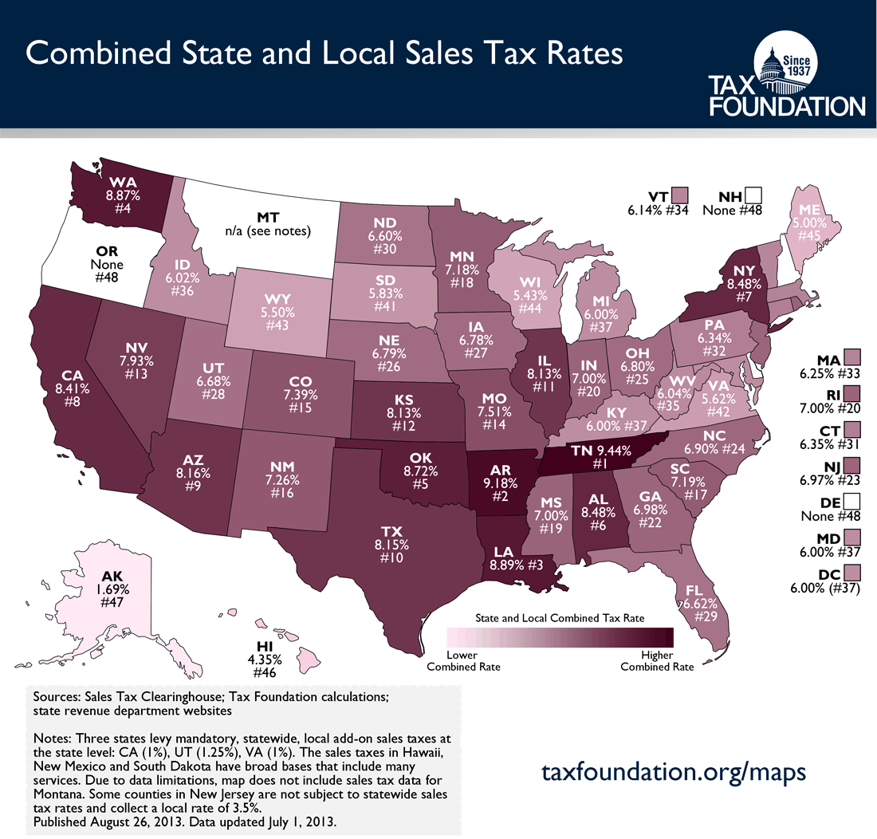
Taxes on Purchases
Sales tax- All but 5 states have a sales tax on purchases.
This often excludes food and drugs.
Excise tax- A “hidden tax” on named items.
Examples include gasoline, alcohol, tobacco, etc…

Slide 5
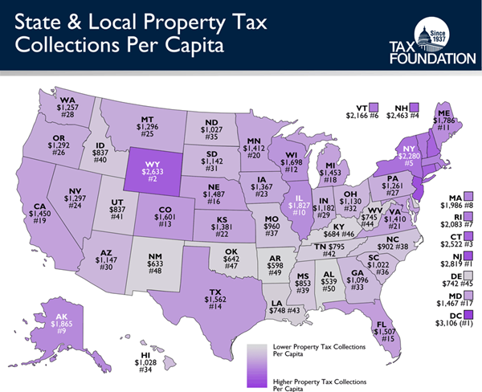
Taxes on Property
Real estate property tax- Tax on land and buildings.
Personal property tax- Tax on certain, usually big ticket items.
(autos, boats, farming equipment, etc.)

Slide 6
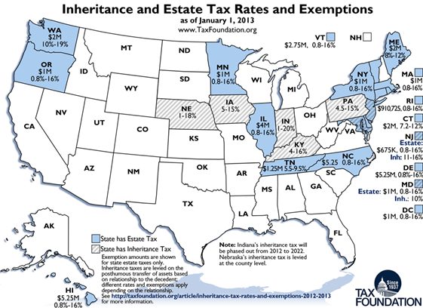
Taxes on Wealth
Federal estate tax- A tax on the value of a deceased persons property.
State inheritance tax- A tax on the value of property received from a deceased person.
Individuals are allowed to give items or money valued at $14,000 (2014) without being taxed. Gifts for tuition and medical expenses are not subject to taxation.

Slide 7
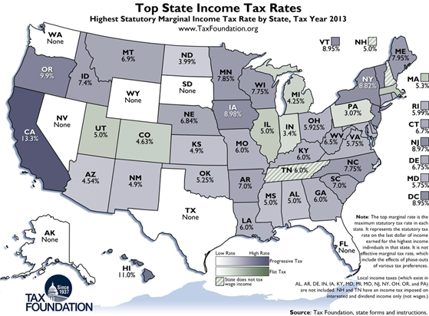
Taxes on Earnings
Income tax- You could be subject to federal, state, and local income tax. Only 7 states do not impose an income tax. Income tax will have a huge impact on your financial planning.
Social Security- Used to fund the Social security and Medicare system.

Slide 8
Question Cluster 1

Slide 9
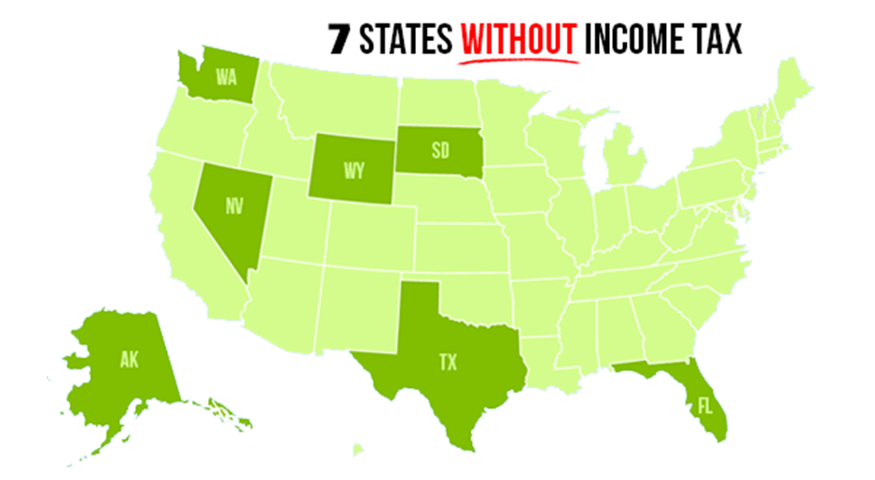
State tax return:
Most states require their income tax to be filed when federal income tax returns are due.
States income tax tends to range from 1 to 10%.
All states have state income tax except for:
Alaska
Florida
Nevada
South Dakota
Texas
Washington
Wyoming

Slide 10
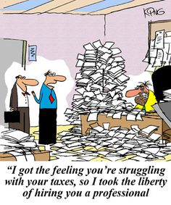
How to file
Ways to file Income tax:
Hire a professional
File on paper and mail in
Purchase software
File online

Slide 11
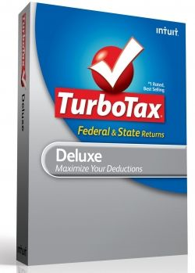
Tax Filing Software
Tax filing software:
Using software opposed to filing on paper can save you 10 or more hours.
When using software you can either print and mail in the form or sent them through online.
Example: TurboTax

Slide 12
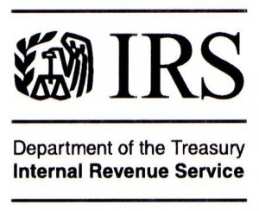
Available Tax Assistance Sources
IRS Services: If you file your own taxes the IRS can assist you in a variety of ways through publications and forms, telephone assistance, and office visits.
There are a variety of different resources available through book publications and internet sites that can also assist you in filing your own taxes.

Slide 13
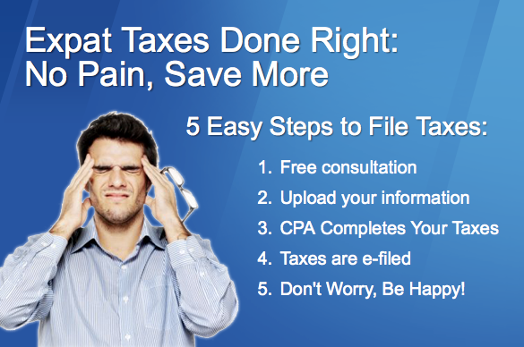
Tax preparation Services:
Over 40 million U.S. citizens pay a professional to do their taxes each year.
CPA generally charge anywhere from $40 to more than $1,000 a year dependent upon the complexity of the return.
CPAs can be individuals who run their own office or employees of a large firm such as H&R Block.
Enrolled agents are government approved tax experts who can legally help to prepare your taxes and provide tax advice.

Slide 14
Don’t Forget:
When selecting a tax service it is important to consider:
The fees charged for filing your taxes as well as how they are determined.
If tax preparation is the primary activity of the office or if it is just a way to introduce new clients to their products.
The training and experience of the professional.
If the preparer will represent the client in the case of an audit.

Slide 15
Question Cluster 2

Slide 16
You need to keep:
Current tax forms and instruction booklets
Social security numbers
Copy of previous year’s returns
W-2 forms from employers
1099 forms (interest, self-employment)
1098 (mortgage interest paid)
Receipts and documentation for expenses
Investment & business expense documents
For 7-10 years

Slide 17
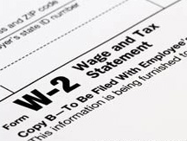
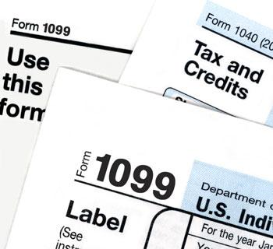
Making Tax Payments
Payroll Withholding W-2 Form
Based on the number of exemptions and the expected deductions claimed. Your employer will usually select this method. Your withholding are taxes paid to the IRS in your name.
Estimated Quarterly Payments 1099 Form
Estimated tax is the method used to pay tax on income that is not subject to withholding. This includes income from self-employment, interest, dividends, alimony, rent, gains from the sale of assets, prizes and awards. It is paid four times a year.

Slide 18
Deadline
“The trick is to stop thinking of it as ‘your’ money.”
– IRS auditor
APRIL 15th!!!
All federal income tax returns are due the 15th of April. The IRS imposes penalties for late payment of tax, for late filing of a tax return, or both. The IRS also charges interest on any unpaid tax.
Submit estimated tax due with Form 4868 by April 15 for an extension.
Reading: Eight Facts on Late filling and Late Payment Penalties
(Source: IRS.gov)

Slide 19
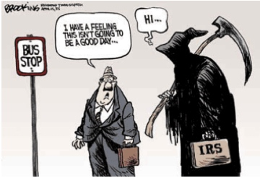
Underpayment
“Make sure you pay your taxes;
otherwise you can get in a lot of trouble.”
–Richard M. Nixon
NEVER underpay your estimated tax.
Underpayment of quarterly estimated taxes may require paying interest on the amount owed
Underpayment due to negligence can result in penalties of 50 to 75 percent.

Slide 20
Question Cluster 3

