Slide 1
Making Smart Purchases
"Most of the things we buy are wants. And we call them needs, but they're wants."
- Dave Ramsey

Slide 2
Learning Objectives
Why are we bad at shopping?
What is the process your brain goes through when you buy something?
What are some effective buying techniques?
How do warranties work?
What can be done if I have a consumer complaint?

Slide 3
Impulsive Shopping
Impulsive shopping is when an unplanned, spur of the moment purchase is made.
For some this can be severe. It becomes an unhealthy obsession with shopping that materially interferes with the daily life of the afflicted. This ailment is considered by some to be psychological in nature. Symptoms include obsession with shopping, anxiety when not shopping, the constant need to shop and the purchase of unnecessary or unwanted items.
Notes:
https://www.youtube.com/watch?v=yhQjG150kdY

Slide 4
Psychology of Shopping
Nowadays, stores are designed to entice you into spending money. The use a variety of psychology techniques to make you open your wallet, including:
Color Use
Layout
Smells
Position of Products

Slide 5
Avoiding Impulse buying
Different techniques work for different people. Some popular methods to reduce unplanned purchases include:
Making a list and sticking to it.
Certain people in your life can make you more likely so spend. Try not to bring them along when shopping.
Give yourself a time limit.
Don’t be tempted by sales.
Some people will need to avoid online shopping. The ability to purchase with a simple click can too easy for certain shoppers.

Slide 6
Effective Buying Habits- Timing Purchases
Prices for many items can vary throughout the year. You can save by holding off on purchases till they are cheaper.
Buying summer or winter clothes at the end of the season will get you bargains.
Ex…..You can save buying Christmas Decorations at the beginning of January.

Slide 8
Question Cluster 1

Slide 9
Price Comparison- Unit Pricing
Unit pricing allows us to more easily compare prices for goods.
Compare the prices of goods by unit (ex. price per ounce on food) to determine which choice is a better deal.
Compare also the price per use for service and clothing purchases.

Slide 10
Store Selection
Where you shop can determine how much you save. You will choose where to shop based on.
Location - Closer and more convenient may mean more expensive.
Price – the cheaper the better, but should you split your shopping between multiple stores?
Product Selection
Services Available

Slide 11
Higher Convenience=Higher Prices

Slide 12
Remember that time and gas are not free.

Slide 13
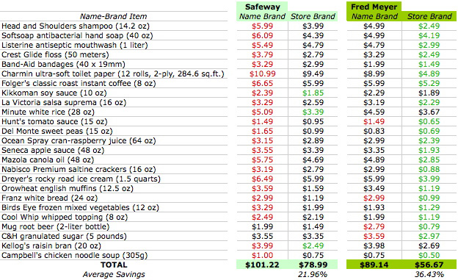
Brand Comparison
Store Brands (or private label) products are often lower in cost and very close in quality to name brand:

Slide 14
Sales don’t always save you money
Sales aren’t always good deals - If you don’t need it does it matter how cheap it is?
Stores use sales to increase foot traffic and ultimately revenues on non-reduced items.
Understand what items are loss leaders (sold below actual value) and how stores use them.
Always keep in mind the impact of quality on sales prices.

Slide 15
Question Cluster 2

Slide 16
Coupons
Are clipping coupons worth your time and effort?
Extreme couponing takes a lot of time, organization, and storage.
You may end up buying items you don’t need.
You may end up buying items that have not been tested for quality by others.
Companies are altering their coupon-rules to limit their loss due to coupon-use.

Slide 17
Online shopping
There are several benefits to online shopping:
Save time
Save fuel
Save energy
Compare prices
Open all day
Competitive prices
However, online shopping can also hurt your pocketbook!

Slide 18
Warranties
A warranty is a guarantee from the manufacture or the distributer that specifies when and how your product can be returned, replaced or repaired.
Express Warranty
Full Warranty- If the product is defective it will be fixed or replaced.
Limited Warranty- Covers only a certain part of the item.
Implied Warranty
Warranty of Title
Warranty of Merchanibility
Are warranties always worth it?
Usually not worth it, research your product
May give peace of mind

Slide 19
Resolving Consumer Complaints
Step 1: Return to place of purchase
Remain calm. Yelling at employees will most likely not help
Step 2: Contact company headquarters
Call, Write, or Email your complaint.
Step 3: Obtain consumer agency assistance
BBB provides pre-purchase information
File a complaint on line at http://www.bbb.org
Step 4: Take legal action
Always remember; Is this worth my time?
You might want to take these actions if you buy a faulty television, probably not so much for a gallon of milk.

Slide 20
Question Cluster 3

