Slide 1
MODULE 6 GOAL SETTING
“All successful people have a goal. No one can get anywhere unless he knows where he wants to go and what he wants to be or do.”
–Norman Vincent Peale

Slide 2
Learning Objectives
The importance of goal creation
Goal setting strategies
Know how to create SMART Goals
How to prioritize goals

Slide 3
The Importance of Goal Setting
What good is a roadmap if you don’t know where you want to go?
You must know your current location, A, in order to get to your target destination, B.
Being busy ≠ being productive
Always be asking yourself: does this move me closer or move me further from my goal?
“Discipline is the bridge between goals and accomplishment.”
-Jim Rohn (entrepreneur, author and motivational speaker) “
Reading Assignment: Why You Should Be Writing Down Your Goals

Slide 4
Everyone's goals are different
Everyone has their own unique goals depending on their situation including values, age, marital status, etc.
While the goal of a teenager may be to save for college, the goal of the grandparent may be to preserve their retirement money.
Maslow’s Hierarchy of Needs will impact goals (Lesson 1)
Every goal is a financial goal:
Most goals involve money
All goals take time that could be used earning money
All goals have opportunity costs
Strive to manage your time in a way that maximizing your overall wellbeing – is there anything you need to change?
Reading Assignment: What you should save by 35, 45, 55 To Be on Target

Slide 5
Question Cluster 1

Slide 6
Things to Ponder When Setting Goals
Determine your ideal quality of life
Be specific - what is your desired family, health, education, career, home, car …
What steps will you need to take to reach those goals?
Are you currently using your time, energy, money and other resources effectively to achieve that desired life?
Is there anything you need to give up in order to focus your resources effectively?
How do you define success?
Is your vision of an ideal quality of life equivalent to success?

Slide 7
Goal Setting Strategies
Goals that are more likely to be achieved possess the following characteristics:
Specific and positive outcomes
Aim to learn skills
Focused on the internal rewards rather than external
Example: importance and value of acquiring an education rather than simply a piece of paper i.e., college degree.
Can strongly commit
Highly desirable
Highly feasible
Source: Strategies of Setting and Implementing Goals

Slide 8
Strategy for Setting & Implementing Goals
Example: Bo is taking a driver’s education course so that he can get his driver’s license. Bo has no previous experience driving and does not know the rules of the road. Although Bo believes he is perfectly capable of learning to drive on his own, his mother insists that he enrolls in a driver’s education course.
Can you identify goals that will most likely result in Bo’s achievement? 1. Specific -_____________ 2. Positive outcome -_________ 3. Skills learned -____________ 4. Internal reward -__________

Slide 9
Strategy for Setting & Implementing Goals
Example Answers: Bo would be more likely to achieve if:
1. Bo’s specific goal was to successfully complete his driver’s education course and earn a driver’s permit within 3 months.
2. Bo focused on the positive outcomes of making his mother happy, educating himself on the rules of the driving, and feeling safer behind the wheel.
3. Bo actually learns driving rules, information, and procedures in order to be a more educated driver, promote driving safety, and avoid traffic violations. 4. Bo does not want to be that driver whom other drivers honk at.
Can you identify goals that will most likely result in Bo’s achievement? 1. Specific -_____________ 2. Positive outcome -_________ 3. Skills learned -____________ 4. Internal reward -__________

Slide 10
Time-Management Tips for Students
Learn to focus.
School - whether lecture, reading, or problem sets - requires sustained attention.
Young people get their content in 140-character units, in 20-second bursts, or with lots of video.
School is not Facebook, YouTube, or Hulu.

Slide 11
More Time-Management Tips for Students
Learn to focus without breaks and without additional stimulation for 15- to 20-minute intervals.
The goal is to reprogram the brain for more focused attention.
Doing so will prevent continual re-focusing and overcome resistance 50 times an hour
Reading assignment: Top 12 Time-Management Tips

Slide 12
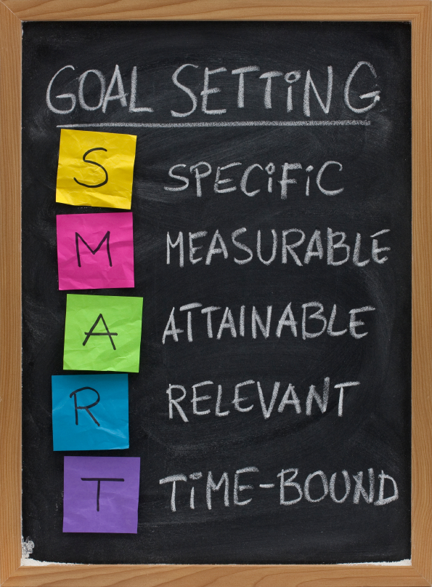
Creating SMART Goals
Smart goals are goals which must be
Specific
Measureable
Attainable
Relevant
Time Bound

Slide 13
SMART - Specific Goals
Specific goals clearly state the exact action to accomplish.
Goals that are too general/not specific enough:
“Save money for retirement”
“Get a college degree”
Goals that are more specific:
“Invest five percent of paycheck into 401K retirement account.”
“Get a college degree in Finance”

Slide 14
SMART - Measurable Goals
Measureable Goals use numbers and benchmarks to measure your progress towards a goal.
Goals that are not measurable include:
“Save money for a car”
“Lose weight”
Goals that are measurable:
“Save $20,000 for a car”
“Lose 20 pounds”

Slide 15
SMART - Attainable Goals
Attainable goals have a reasonable chance of success under current situations.
Goals that are not reasonably attainable include:
“Win $200 million in the Powerball Lottery”
“Vacation on Mars”
Goals that are attainable:
“Buy a 2015 Ford F-150 Truck”
“Vacation in Hawaii”

Slide 16
SMART - Relevant Goals
Relevant goals are goals which are appropriate for your certain situation.
Goals that are not relevant include:
A work goal of “Beating a high score on a video game.”
A parent’s goal of “Contributing 5% of gross income to their child’s retirement fund.”
Goals that are relevant:
Having a work goals of “Increasing productivity by 10%.”
A parent’s goal of “Contributing 5% of gross income to college savings.”

Slide 17
SMART – Time Bound Goals
Time bound goals have a time period or date for the goals to be achieved. Time constraints on goals force action within a certain time period and allow for effective time budgeting.
Goals that are not time bound include:
“I plan to retire someday.”
“I plan to obtain my bachelors degree.”
Goals that time bound:
“I plan to retire before I turn age 62.”
“I plan to graduate with a bachelors degree in finance before May, 2019.”

Slide 18
Were your goals SMART goals?
Go back to the goals you made in Module 1. INITIAL GOALS
Were these initial goals clear enough to really let you accomplish them?

Slide 19
Question Cluster 2

Slide 20
Goal Time Frames
Immediate goals – Achieve within one year.
Example: find a part time job
Short term goals – Achieve in one to five years.
Example: obtain bachelors degree in finance
Reading Assignment
Intermediate term goals – Achieve in five to 15 years.
Example: buy a home
Long term goals – Achieve in 15 to 30 years.
Example: save enough to retire at set age
Far reaching goals – Achieve before death
Example: Leave an estate worth $5 million for children

Slide 21
Prioritizing Your Goals
Some goals may be more important than others or due to their time constraints may need to be finished before others. Therefore it is important to prioritize your goals.
Ex. Paying off credit card debt should generally be high priority, while saving for a vacation would often have less priority.

Slide 22
Assignment: Polish your personal goals.
Make sure your goals from Lesson 1 are clear and concise SMART goals then assign them a priority as well as time frame.
Note: Your goals will require constant review and revision, your goals will likely not be the same even five years from now.

Slide 23
Question Cluster 3

