Slide 1
Investments: The Basics
“How many millionaires do you know who have become wealthy by investing in savings accounts? I rest my case.” –Robert G. Allen

Slide 2
Learning Objectives
Why should you invest
Types of investments
Types of investors
Risk verse Reward

Slide 3
Why invest?
Why Invest? (Source: Investor.gov)
Introduction to Investments (Source: Investopedia)
YouTube: Importance of Investments
Investing is the key to building long term wealth.

Slide 4
Why invest?
Investing is not a get rich quick scheme.
Investing is not gambling.
Investing means putting your money to work for you.
Investing is the key to building wealth.
You cant rely on pension plans or social security plans anymore, investment is becoming more and more of a necessity.
People living longer, prepare for longer retirement, need bigger retirement fund
Notes:
http://money.usnews.com/money/blogs/on-retirement/2014/03/13/why-young-people-shouldnt-hesitate-to-invest

Slide 5
Who will have the most at retirement (65)?
Little Lisa: Parents put $3000 into retirement account at birth with no additional contributions
Prudent Paul: Starts investing $3000 a year at 18 making his last contribution at age 25
Procrastinating Pete: Pete waits until age 26 to start putting away $3000 a year until age 65.
Assume 10% tax deferred return on investments
What about at a 7% tax deferred return?

Slide 6
Investment Returns
Lisa receives 44x her investment back
Paul receives over 12x his investment back
Pete only receives 3.7x his investment back

Slide 7
Question Cluster 1

Slide 8
Before you start:
Although it is important to begin investing as soon as possible as it will yield higher rewards it is also very important to make sure you are financial stable enough to begin. Keep this pre investment checklist in mind.

Slide 9
Pre- Investment checklist
Pre investment checklist- What you should have started before you invest.
Balanced Budget
Make more than you spend
Insurance
Rainy day fund
Pay off debt, high interest rate stuff goes first. Some experts recommend investing while paying off debt at the same time.
401k first- Especially if your employer offer matching funds. This is FREE money.
Notes:
http://www.sec.gov/investor/pubs/tenthingstoconsider.htm

Slide 10
TO THINE OWNSELF BE TRUE: What are your investment goals?
Remember your smart goals, making investment goals will be very similar.
Example: I want $150,000.00 for my children's education. I will invest a percentage of my disposable income in Mutual Funds. I want to reach my goal by the time my first child is 18.
Notes:
http://mutualfunds.about.com/od/ValuevsGrowth/a/What-Is-Your-Investment-Style.htm

Slide 11
Your investment style: (must change)
Sally believes that the key to investing is to buy small companies that are poised to grow at extremely high rates. Sally is therefore always watching for the newest, most cutting-edge technology, and typically invests in technology and biotech firms, which sometimes aren't even making a profit. Sally doesn't mind because these companies have huge potential. John isn't ready to go spending his hard-earned dollars on what he sees as an unproven concept. He likes to see firms that have a solid track record and he believes that the key to investing is to buy good companies that are selling at "cheap" prices. The ideal investment for John is a mature company that pays out a large dividend, which he feels has high-quality management that will continue to deliver excellent returns to shareholders year after year.
http://www.investopedia.com/video/play/pick-your-investing-style/
Notes:
http://www.investopedia.com/financial-edge/0410/6-investment-styles-which-fits-you.aspx

Slide 12
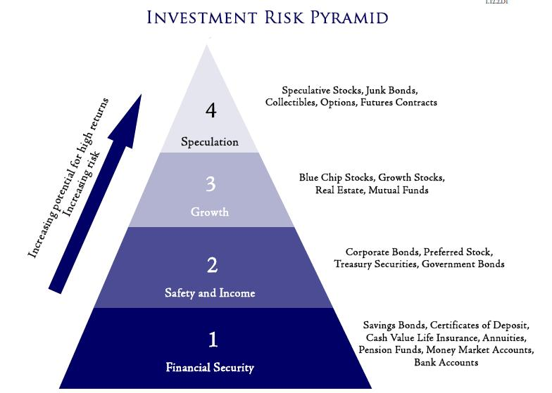
WHATS THE RISK????
Safety vs Risk.
The greater the risk,
The greater the potential Reward
Notes:
http://www.investopedia.com/articles/basics/03/050203.asp

Slide 13
What's the Risk?
Inflation risk - remember inflation from the TMV module. If inflation rises enough it could exceed the returns your are receiving from your investments resulting in a lower purchasing power than you began with.
Interest rate risk - Changes in interest can inversely affect the value of certain investments such as stocks and bonds.
Business failure risk - If the business you invested in goes out of business that was not a solid investment.
Market risk - Risk associated with participating in the stock market. Related to current economic conditions as well.

Slide 14
Investment Income
Income coming from interest payments, dividends, capital gains collected upon the sale of a security or other assets, and any other profit that is made through an investment vehicle of any kind.
http://www.investopedia.com/terms/i/investmentincome.asp
Many people like a sure thing. When talking about investment income we are usually referring to interest and dividends earned from the safest investments. You'll know how much you're getting and when you're going to get it.
Your investment income goals are the “defense” in your investment plan.

Slide 15
Investment Growth
Growth= My investment will increase in value.
I bought a share of stock for $5.00, a year later it is worth $8.
Making your money grow is the most essential investment objective. Investing for growth is riskier but ultimately more profitable than investing for income.
Common Stock is considered the best investment for growth.
Investing for growth is the “offense” in your investment plan.

Slide 16
Investment Liquidity
Remember from previous chapters that liquidity is the ability to sell an asset quickly without affecting the value of the asset (in this case an Investment).
Some investments (Such as Certificates of Deposit) have penalties for withdrawing the money early.
Other investments can be sold very quickly. This will be dependent on many conditions.

Slide 17
Basic types of investments

Slide 18
How can we reduce risk?- Asset Allocation
The process of putting your eggs into a number of carefully selected baskets
When some baskets fall as inevitably occurs, other baskets still have eggs
Examples include:
Conservative= Less risk/less reward
Aggressive= More risk/more reward
The way you allocate your investments is often considered more important than the individual investments (companies) you select.
YouTube video: Allocation vs. Diversification

Slide 20
How can we reduce risk?- Time
Time:
More time to grow.
More time to recover from setbacks.
Notes:
http://www.investopedia.com/articles/investing/110813/using-time-horizons-investing.asp

Slide 21
How can we reduce risk?- Time
This looks bad…….

Slide 22
How can we reduce risk?- Time
Look at the big picture. Even with a large dip in the market your investment will still grow.

Slide 23
How can we reduce risk?- Age
Your age:
Invest appropriately for your age. The younger you are the more time you have to recover any lost investments.
Rules of thumb:
Subtract you age from 110 and the difference is the percentage of your assets that should be invested in growth investments such as stocks while the remainder of your money should be in more conservative investments (Ex. Bonds).
Rule of Thumb at retirement (7 to 10 years of low risk investments to cover living expenses)

Slide 24
What's my role in all of this?
Do your research:
You need to put in time and effort.
Determine and communicate clearly and effectively your investment GOALS.
Investing should be considered a job. Are you putting in enough time to be the most effective? Are you possibly spending too much time and driving yourself crazy?

Slide 25
What's my role in all of this?
Keep track of the value of your investments
Current technology allows you know the value of your investments in seconds.
Changes in:_________ need to be reflected in your investments.
The Market
Yourself (Income, Net worth, life needs and goals)
Monitor enough to stay in the loop, too much can drive you crazy.
Notes:
http://www.forbes.com/sites/robertberger/2014/04/16/the-best-online-tools-to-track-your-investments/

Slide 26
What's my role in all of this?
Keep accurate paper and electronic records
Serves as tool to analyze and refine your investing.
Helps you decide to drop the investment or buy more.
Tax purposes

Slide 27
What's my role in all of this?
Seek out professionals
Many people do not have the confidence or expertise to invest alone. Lawyers, accountants, stockbrokers, insurance agents and others have vital expertise that can help with your decision making\
Reading: Investopedia-How to Choose a Broker
Reading: 10 Questions to Ask When Choosing a Financial Advisor

Slide 28
What's my role in all of this?
Recognize and Avoid Fraud
Reading: What You Can Do to Avoid Investment Fraud (Source: Investor.gov)
Reading: Internet Fraud (Source: U.S. Securities and Exchange Commission)
Notes:
https://investor.gov/investing-basics/avoiding-fraud/what-you-can-do-avoid-investment-fraud#.U_-Tqj8UTeQ

