Slide 1
Module 3 Time Value of Money
“If you would know the value of money, go and try to borrow some.”
– Benjamin Franklin

Slide 2
Learning Objectives:
Understand how time effects the value of the dollar.
Understand interest rate
Understand Inflation

Slide 3
Money today is worth more than money tomorrow:
Would you rather have a hundred dollars today or a hundred dollars five years from now?
One hundred dollars today is worth more than a hundred dollars in five years.
Why is this true?
Money today could be invested or saved to produce more money from interest earned.
Therefore logically you would rather have the hundred dollars today than five years from now.
Reading: Why the Time Value of Money Matters, and 10 Ways It Affects You
YouTube Video

Slide 4
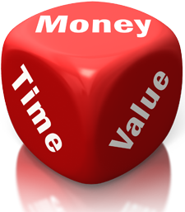
Time value of money
Time value of money: the increase of money as a result of interest earned over time.
By spending money you lose possible interest that could have been earned in the future.
The time value of money needs to be evaluated every time you partake in an activity such as borrowing, spending and saving your money.
YouTube Video

Slide 5
Cluster 1

Slide 6
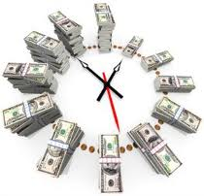
Delay Discounting-
A decrees in the value of a reward as time goes on.

Slide 7
Interest rate
Interest rate- is the “cost of money,” what you pay for taking out a loan.
Interest rate is the rate paid by the borrower for the use of the lenders money. (Rent on money)
Borrowers with poor credit pay higher interest rates than those who have good credit.
Highly influenced by supply and demand.
Reading: How do interest rate affect you? (Source: Bankrate.com)
YouTube Video: Interest rates

Slide 8
Interest Rate
Has a large effect on financial planning:
With low interest rates:
Less investors are willing to save as they will not make as much money on their savings. They will therefore either spend, or look for somewhere else to invest their money that will yield a higher return.
It is less expensive to finance the purchase of an asset, as it will cost you less therefore more investors are willing to borrow money during this time.
With high interest rates:
More investors are likely to save as they are able to make more money from saving.
Less investors are willing to borrow money as it is more expensive to finance assets during this time.

Slide 9
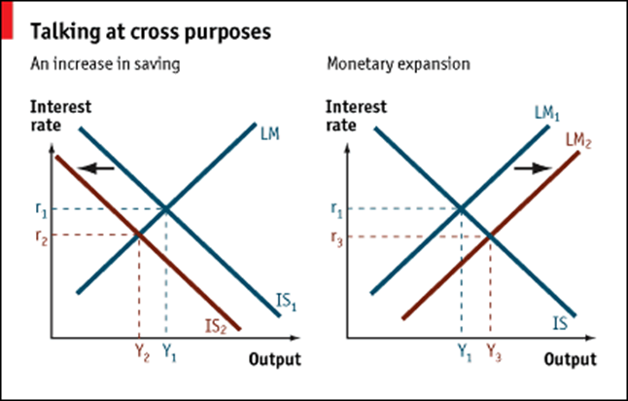
Interest Rate
When supply for money is low and demand is high interest rates are likely to increase and vice versa.
Ex. When many investors are borrowing money opposed to saving and investing their own.
Lower interest rates = Lower consumer prices
Higher interest rates = Higher consumer prices

Slide 10
Cluster 2

Slide 11
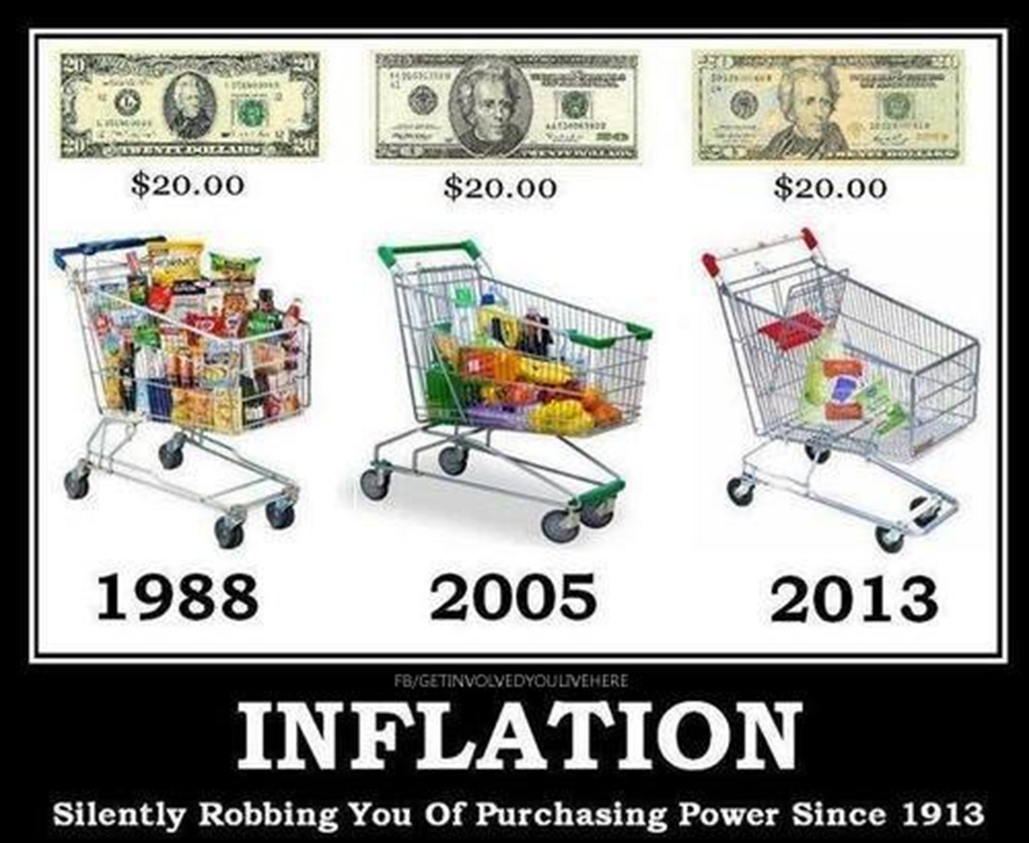
Inflation
“Inflation is as violent as a mugger, as frightened as an armed robber and as deadly as a hit man”
-Ronald Regan
Inflation: is a rise in the level of prices
Inflation tends to be most harmful to those on fixed incomes. Your retirement plan especially needs to take inflation into account. (Investopedia: Inflation)
Reading: Basic Economics (Source: Social Studies for Kids)

Slide 12
Inflation
Inflation rate can vary dramatically. When inflation occurs there is an increase in the amount of money needed to buy the same amount of goods.
Deflation, or the general lowering of prices, can also occur. Contrary to what many think, modern deflation tends to be a bad thing.
The consumer price index (CPI) is the degree of change in prices paid for a fixed number of goods and services given by the Bureau of Labor Statistics. The CPI has been around 2 to 4% in recent years.
Reading: What is the consumer price index CPI (Source: Investopedia)
YouTube video: What is Inflation (Source: Khan Academy)

Slide 13
Cluster 3

Slide 14
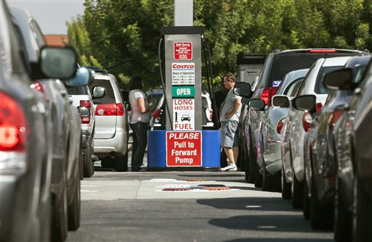
Inflationary Psychology: the tendency for people to spend more because they believe prices are rising. This tendency becomes a self-fulfilling prophecy because as consumers spend more and save less, the velocity of money increases, further boosting inflation and supporting inflationary psychology Example: people stocking up on gasoline while the prices are down.

Slide 15
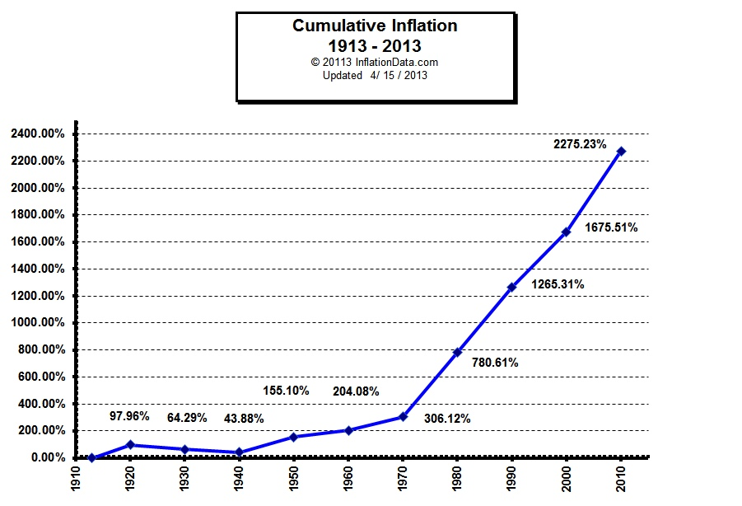
Inflation History
“Inflation is taxation without legislation.”
-Milton Friedman (economist, professor, & recipient of the Nobel Prize in Economic Sciences)

Slide 16
Inflation Calculator: Money’s real worth over time
The inflation calculator uses U.S. government provided Consumer Price Index (CPI) data to measure the purchasing power of the U.S. dollar over time. It’ll provide a look into the present, past or any time between. http://www.coinnews.net/tools/cpi-inflation-calculator/

Slide 17
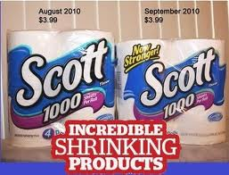
Hidden inflation
Hidden inflation- is inflation that occurs which is not included in the CPI.
It can occur when the costs of everyday necessities such as food, gas, and health care which a person spends the greatest amount of their money on increases more than other nonessential items.
It can also occur when the product quality or quantity declines despite no decrease in price.

Slide 18
Rule of 72
We can easily and closely predict the number of years it will take prices to double.
Rule of 72- divide 72 by the annual inflation rate and the number given equals the number of years it will take for prices of goods to double.
Example: If the inflation rate of the dollar is 9% how many years will it take for the prices of goods to double?
72/9 = 8
So it will take 8 years for the prices of goods to double at an inflation rate of 9%.
Investopedia: Rule of 72

Slide 19
Cluster 4

Slide 20
Simple Interest-
Simple interest- the basic way you accrue interest you make on your own money. Lenders make money from interest, while borrowers pay interest.
Simple Interest = Principal x Rate x Time
Investopedia: Understanding the simple interest

Slide 21
Calculating Future Value (FV) “Compounding interest”
“The most powerful force in the universe is compound interest.”
-Albert Einstein
Future value is the future worth of a present sum of money.
The amount to which a current sum will grow given a certain interest rate and time period
Investopedia: Future Value
Investopedia: Understanding compound interest

Slide 22
Calculating Present Value “Discounting”
Present value is the current worth of a future sum of money.
Investopedia video: Understanding present value

Slide 23
Cluster 5

